Slide 1
HTML Kickstarter For Beginners
Aakash Kumar Nanda(OCPJP, OCAJP)

Slide 2
Agenda
Introduction
What can you do with HTML?
What are HTML tags?
Practical Examples
Saw beautiful websites like Amazon? Learn how to create them
CSS and Bootstrap
Practical Examples
Steps To Create a complete website
Summary

Slide 3
Introduction
The HyperText Markup Language or HTML is the standard markup language for documents designed to be displayed in a web browser.

Slide 4
Html Tags
<tag>Not the Facebook one</tag>

Slide 5
Some Examples
<html> - start of an html page
<body> - actual content of the webpage
<style> - CSS stuff
<script> - Java Script Stuff
Other tags:
<h1>,<h2> etc – header tags
<p> - paragraph
<form> - create a form using this tag
<div> - kind of a container tag

Slide 6
Best way to learn is through Practical Examples!!
“
”

Slide 7
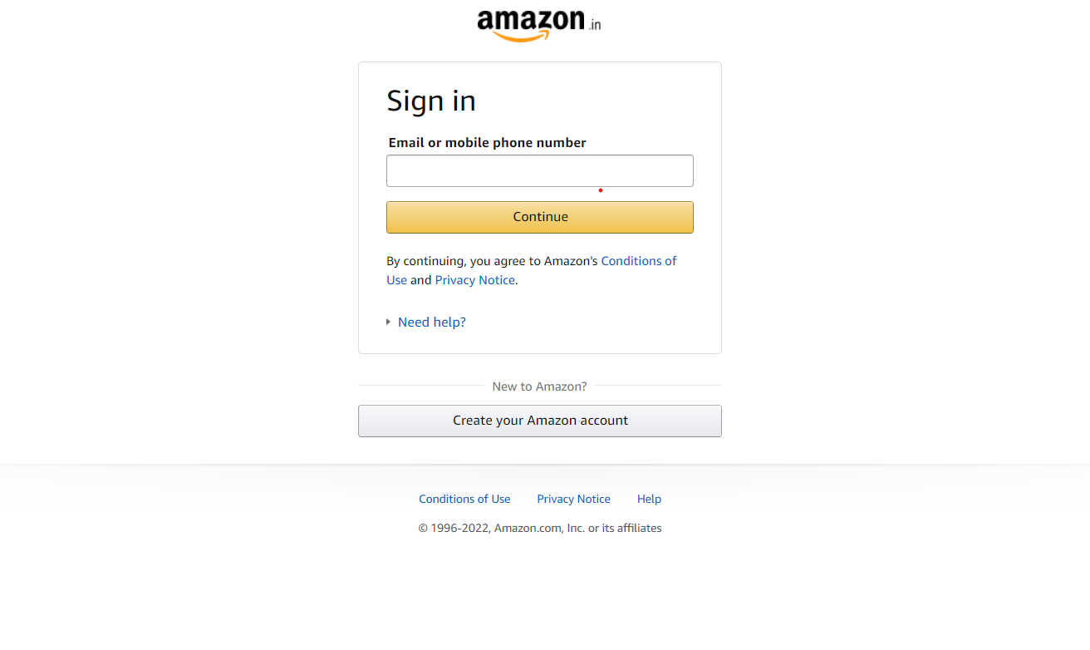
Is there a sale going on?

Slide 8
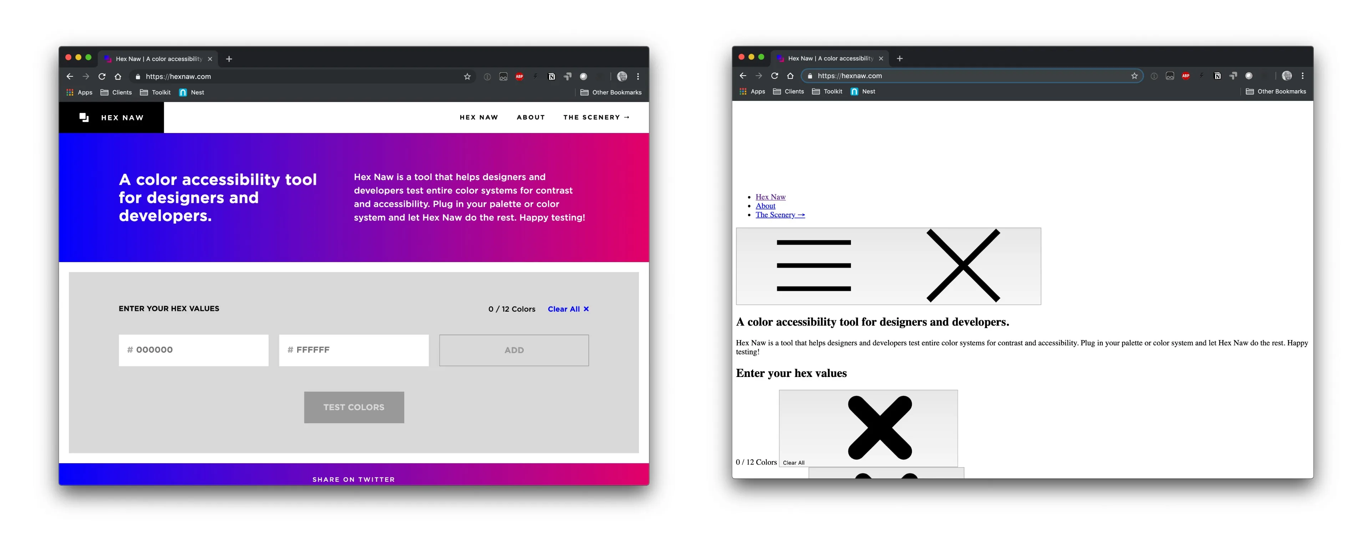
CSS(Cascading Style Sheets)

Slide 9
What is Bootstrap Then?
Bootstrap is the most popular CSS Framework for developing responsive and mobile-first websites.

Slide 10
Best way to learn is through Practical Examples!!
“
”

Slide 11
Steps To Create a Complete Website!!
Create Your Structure using HTML
Add Styles Using CSS
Add Some Spicy JavaScript for Functionality
Connect To Database to Store the data
Deploy!!

Slide 12
Reference Links
My Github Repo - https://github.com/aakash1999/htmlKickStarterWorkshop

Slide 13
Thank you
Mirjam Nilsson​
mirjam@contoso.com
www.contoso.com

